Slide 1


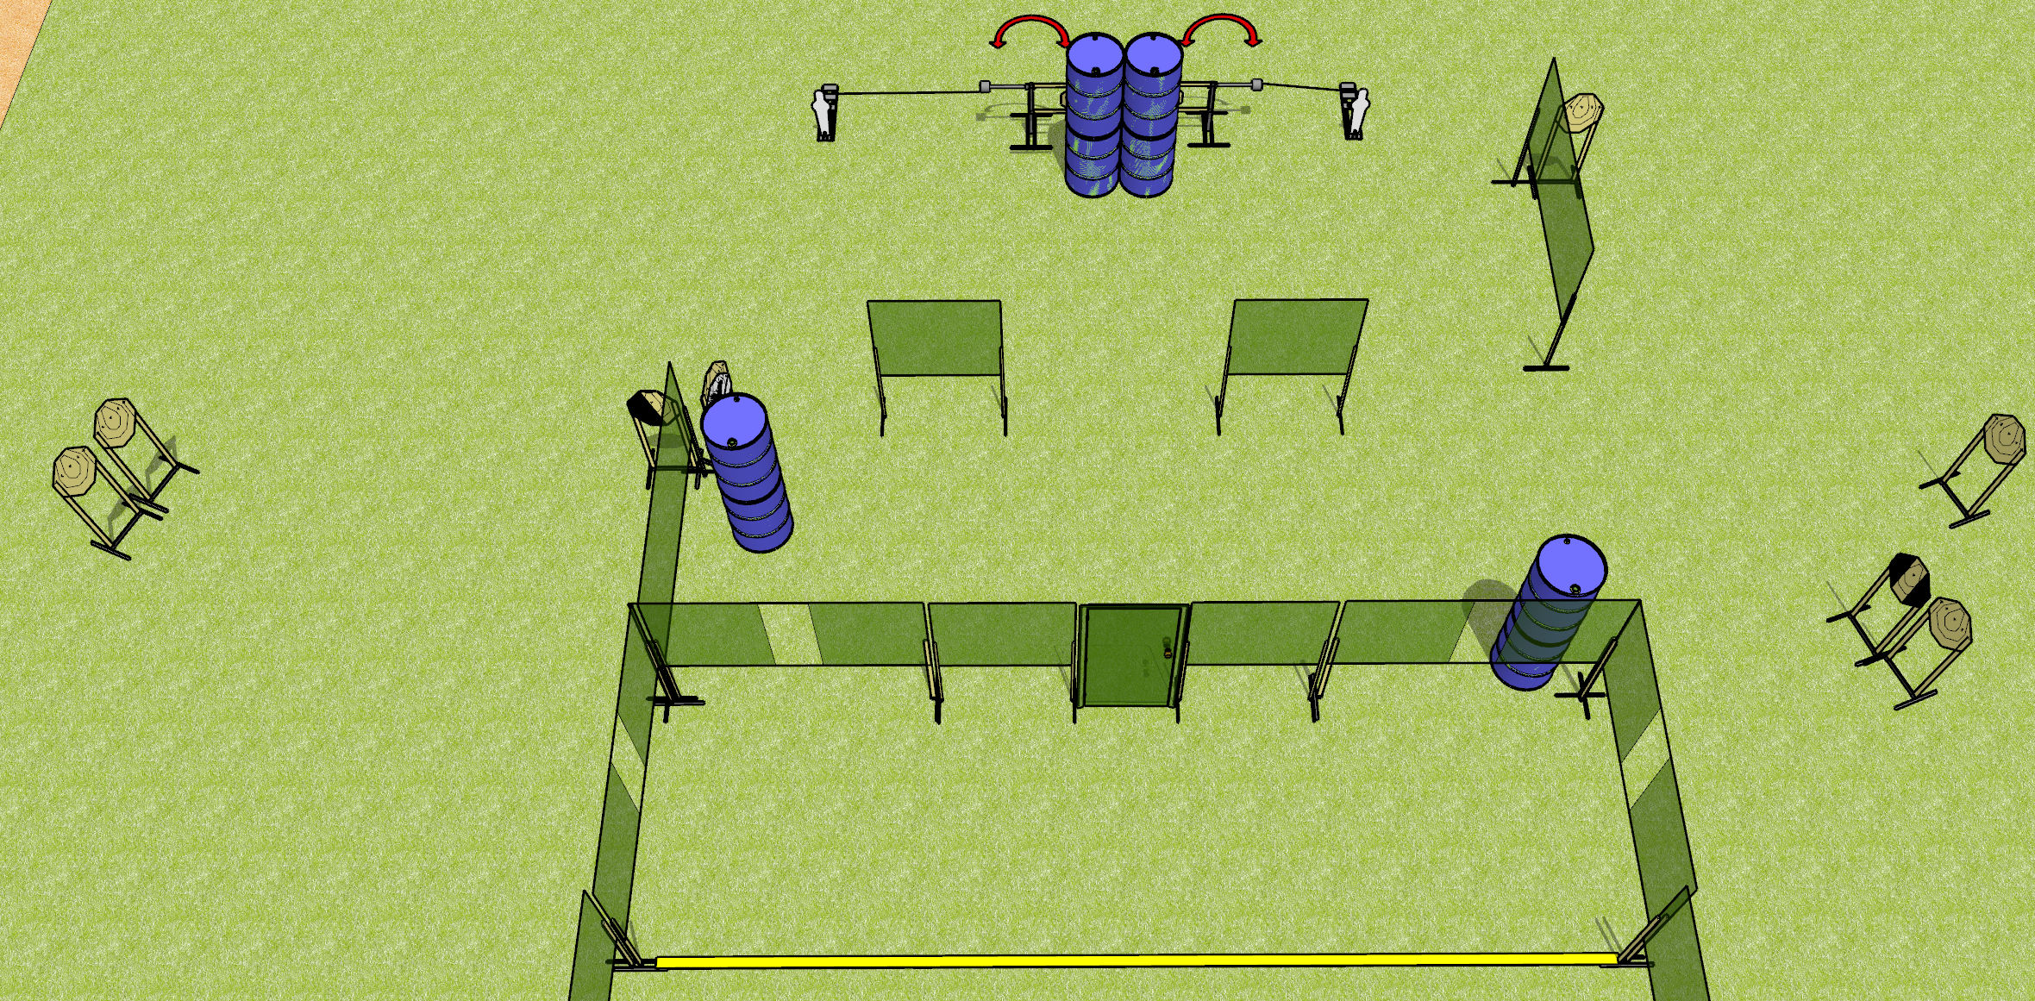
 | Dothan Gun Club – USPSA Match The 1 The Only Course Designer : Drew Coleman
Round Count 12 rounds 10 IPSC 2 mini poppers
Equipment List 2 swingers + 2 activators 8 wall feet 1 diagonal hard cover, 1 tuxedo

Slide 2
The 1 The Only
Written Stage Briefing
The 1 The Only is a 12 round, 60 point, Comstock course of fire. There are 10 IPSC targets and 2 mini poppers. The best 1 hit on paper will score, and steel must fall to score. The start signal is audible.
The left swinger is activated by the left popper, and the right swinger by the right popper. Both swingers are visible at rest. Please check the activators prior to walkthrough and set them the same way every time.
The door must be shut prior to the start signal for every shooter.
Handgun start position is anywhere inside the shooting area, wrists below belt. Handgun is loaded and holstered.
PCC start position is anywhere inside the shooting area, stock on belt. Loaded carbine is held with both hands, safety on.
On start signal, engage targets as they become available from within the shooting area.

